Slide 1

World CO2 Emission Visualization
GROUP: Statistics 1
NITHIN SAI NANDELLI (02011171)
ROHITH KIRAN CHALASANI (02066047)

Slide 2
GLOSSARY
INTRODUCTION
TASK
SCREENSHOTS OF THE PROJECT
CONCLUSION
POSSIBLE IMPROVEMENTS
REFERENCES

Slide 3
INTRODUCTION
For our project we considered a major problem our world is facing currently: Global warming. The main cause for Global Warming is Carbon dioxide.
We are trying to visualize the trends in the rise of carbon dioxide levels in the atmosphere.
The Levels of carbon dioxide have been rising at a massive rate since the early 1900’s.
We are trying to visualize the data from the year 1990-2018 collected from the US energy information administration.

Slide 4
INTRODUCTION
We are trying to build an interactive world map along with few other charts related to the interactive world map.
Along with the Interactive world map we are also making an interactive bar chart and a line chart .
All the figures on the webpage are interactive.

Slide 5
TASK
On the webpage there will be a world map.
When the mouse passes on a country in the map, the country will be highlighted and the co2 levels will be shown.
If you click on the map, The map is zoomed to that country and the charts below the map shows the details of co2 emissions of the selected country.
The bar chart shows the co2 emitted from different sectors
Line chart represents the co2 emissions of the selected country from 1990-2018

Slide 6
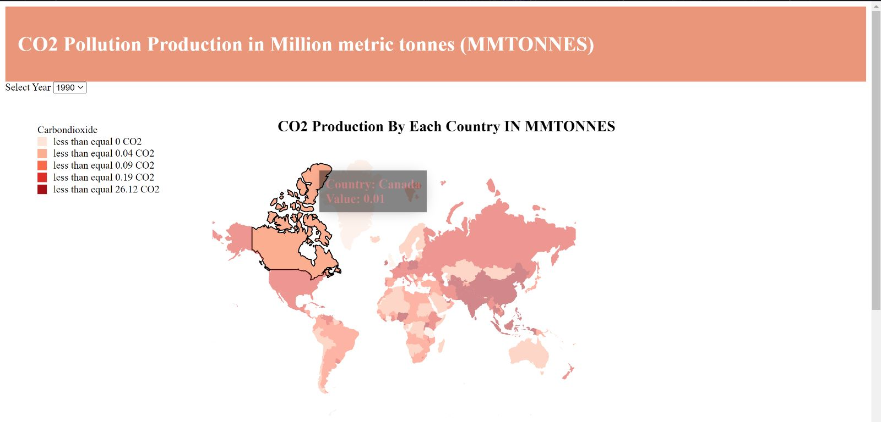
SCREENSHOTS

Slide 7
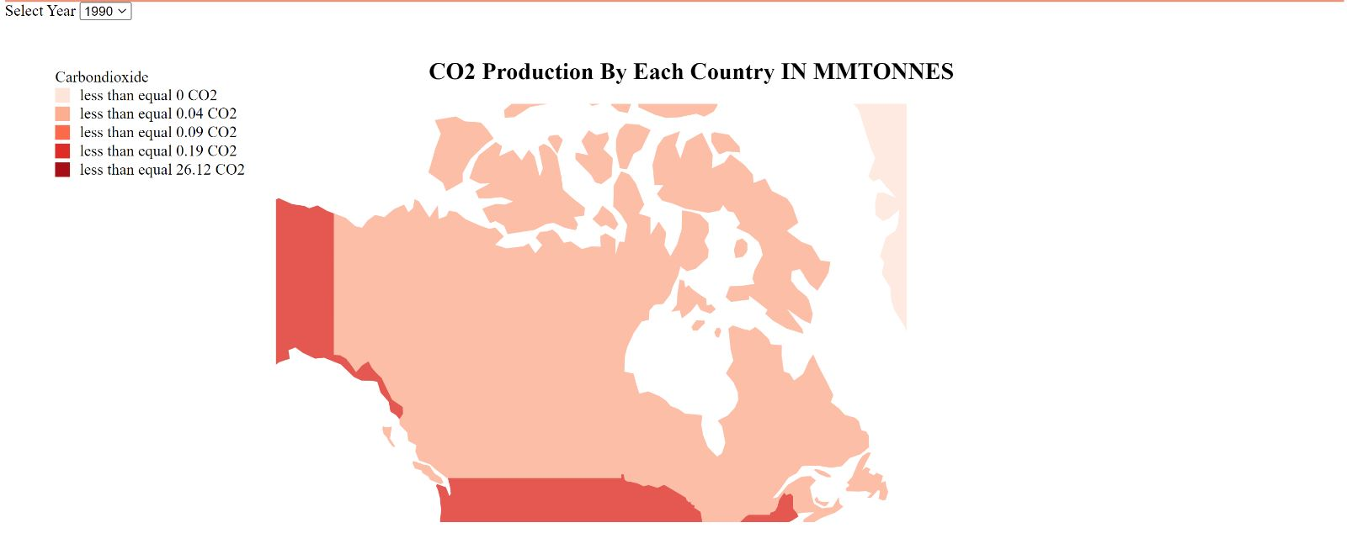
SCREENSHOTS

Slide 8
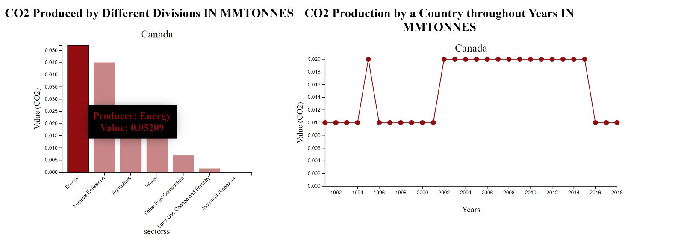
SCREENSHOTS

Slide 9
CONCLUSION:
By using this interactive map and other charts we were able to see how there is a change in co2 levels in our world.
We are also able to look at some specific details like which sectors from a country are providing more c02.
We can also see how a country is doing each year from 1990-2018.

Slide 10
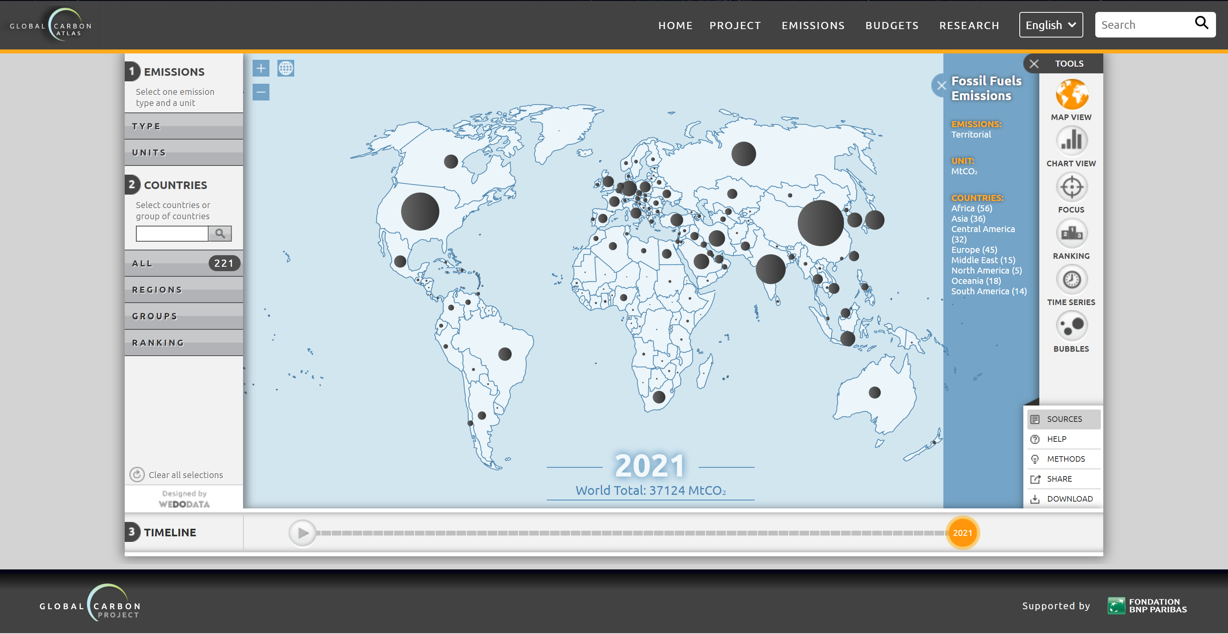
POSSIBLE IMPROVEMENTS
We took this chart as a reference and if we take a look at it, We can include a lot of things from the webpage.
We can add a search bar, rankings throughout the years and various other filters

Slide 11
POSSIBLE IMPROVEMENTS
The years could be made into a slider and the map can be animated.
There could be a play button that could take us on a journey in the variations of CO 2 levels throughout the years.
Adding custom zoom buttons on the map.

Slide 12
REFERENCES
https://www.eia.gov/international/data/world/featured-view/4?pd=5&p=000000000000000000000000000000000000000000000020000007u00006&u=0&f=M&v=mapbubble&a=-&i=none&vo=value&&t=C&g=00000000000000000000000000000000001a1&l=176--176&l=174--174&l=178--178&l=184--184&s=94694400000&e=1669852800000
This is the website of US Energy Information Administration
http://www.globalcarbonatlas.org/en/CO2-emissions

Slide 13
THANK YOU

